Slide 1
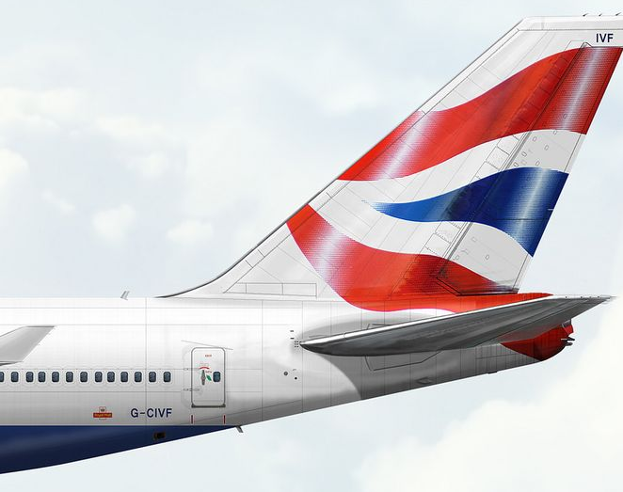
BRITISH AIRWAYS
- Task1: Customer Review Sentiment Analysis and Insights.

Slide 2

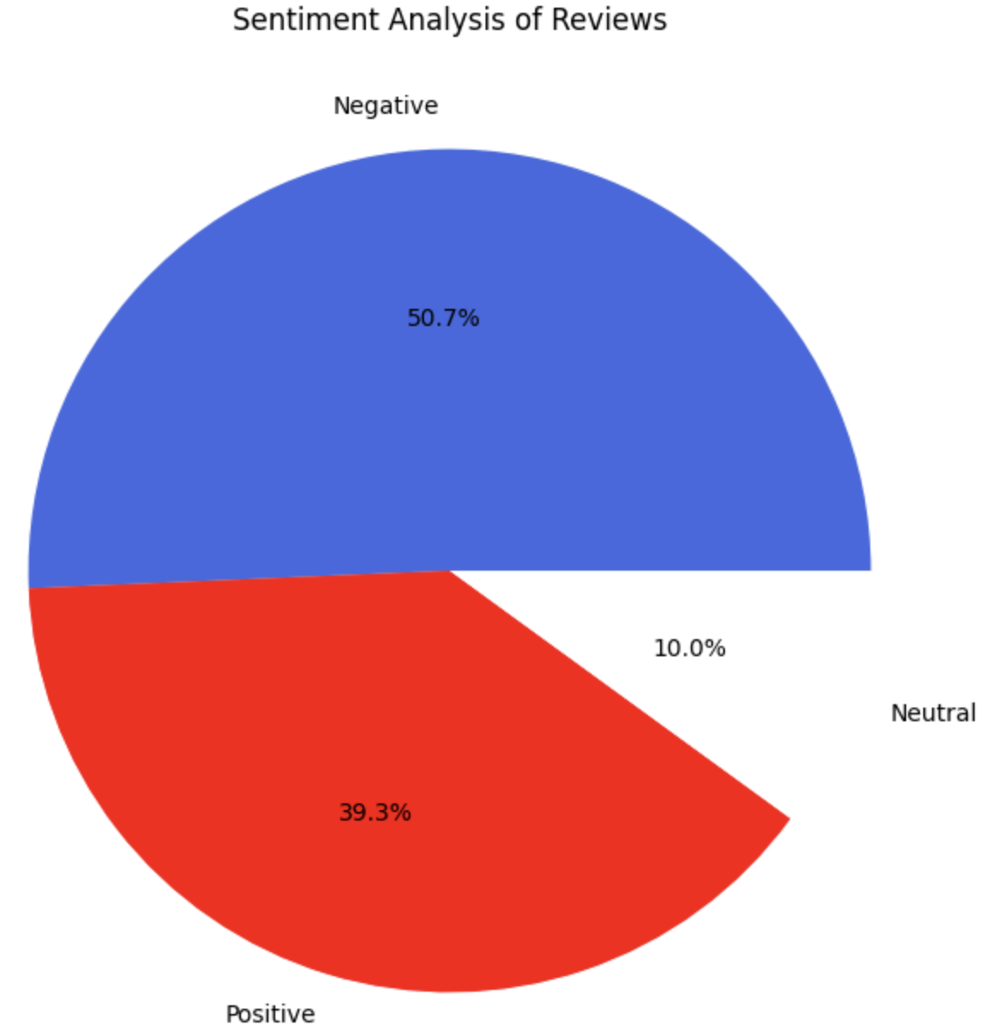
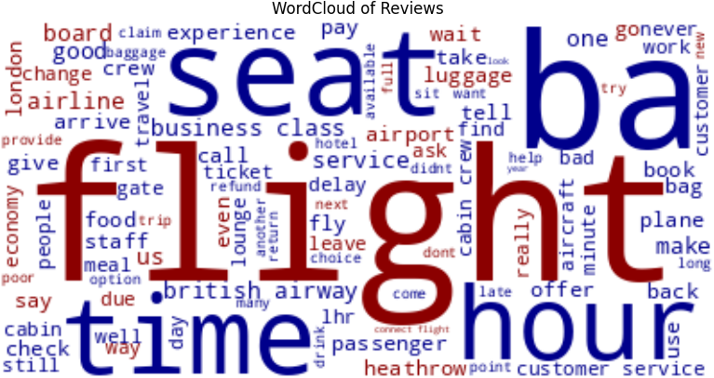
Summary and Insights:
1000 reviews has been scraped, cleaned and analyzed.
From the analysis,
Positive Reviews - 507
Negative Reviews - 393
Neutral Reviews - 100

